Slide 1
Today’s Roadmap
Append (quick wrap-up)
Collapse
Intro to the PSID
Reshape

Slide 2
A Quick Intro to the PSID
Notes:
Please refer to your syllabus!

Slide 3
Panel Study on Income Dynamics (PSID)
Longest running longitudinal household survey in the world
18,000 individuals in 5,000 households
50 years of data on the same families and their descendants
In other words, it’s a PANEL dataset!
More info: https://psidonline.isr.umich.edu/Guide/Brochures/PSID.pdf
Intro to PSID
Reshape

Slide 4
Panel Study on Income Dynamics (PSID)
We’re going to gather descriptive statistics on student loan debt by age
Navigate to the Cross-Year Index in the Data Portal
Variables (under the Family Public Data Index):
Wealth > Student Loans > 2011, 2013, 2015
Demographic > Age > Head + Spouse > 2011, 2013, 2015
Sample Weight > Longitudinal > Combined Core and Immigrant > 2011, 2013, 2015
Intro to PSID
Reshape

Slide 5
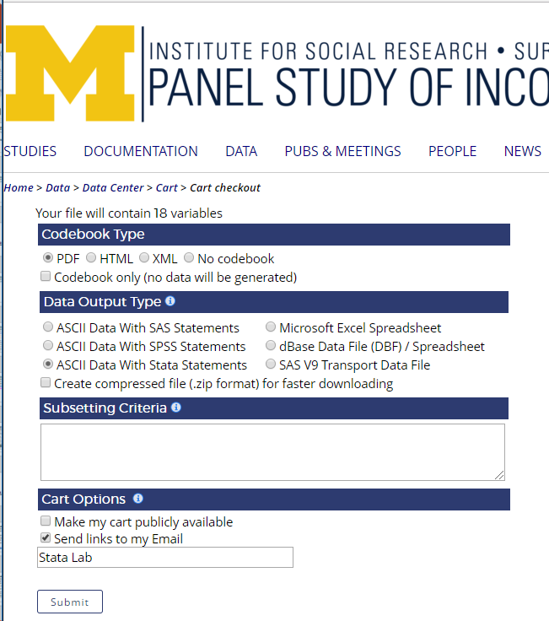

Slide 6
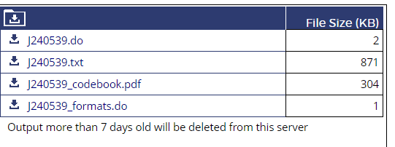
Panel Study on Income Dynamics (PSID)
Once your data is done processing, it will come back like this
Download the do file and the txt file (the do file will format the txt file)
Intro to PSID
Reshape

Slide 7
Reshape
Notes:
Please refer to your syllabus!

Slide 8
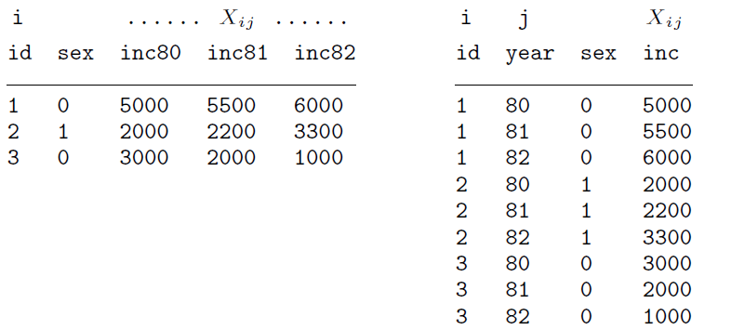
Reshape
Reshape transforms data from long to wide or vice versa
Useful for panel data, as well as other applications
Log Files
Stored Statistics

Slide 9
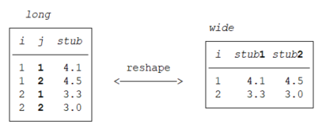
Reshape
reshape wide stub, i(i) j([existing variable])
reshape long stub, i(i) j([new variable])
Reshape
Questions

Slide 10
Reshape
reshape long inc, i(id) j(year)
reshape wide inc, i(id) j(year)
Note: everything after the comma is required – this is not an option
Log Files
Stored Statistics

Slide 11
Reshape
Wide to long: the contents of everything after the stub is turned into a new variable (year)
Long to wide: year gets turned into a part of the stub variables
Log Files
Stored Statistics

Slide 12
Reshape Practice
What format is the PSID data currently in?
Let’s try to transform it so that we can complete some descriptive statistics by year for student loan data
Reshape
Questions

Slide 13
Local and Global Macros
Notes:
Please refer to your syllabus!

Slide 14
Local Macros
A convenient tool to switch out variables or numbers
local [macro name] [#] for a numeral
local [macro name] [var] where bob is an existing variable
But what’s the use in this?
Collapse
Intro to PSID

Slide 15
Local Macros
But what’s the use in this?
We can refer to our locals in place of numbers or variables by referring to the `local name’, for instance:
local age 21
gen age_min = `age’ this is generating a new variable equal to the local age
local age 18 this is resetting the local to a new number, so anywhere we have `age’ in our code will also change
Collapse
Intro to PSID

Slide 16
Global Macros
There are also global macros, which work along the same principal, with a key difference:
Local macros work on the chunk of code that you run along with the local
Global macros work on all chunk of code within that DO file in that particular session
The syntax is just the same, except you switch local for global
global [macro name] [var] global is used in place of local
Collapse
Intro to PSID

Slide 17
Global Macros
To refer to a global macro in your code, you use a $ before the macro name instead of a `’ around the macro name
local age 18
gen age_min = $age
Collapse
Intro to PSID

Slide 18
Macros
We are not limited to including only one element in a macro
For instance, we could put all of our independent variables of interest in a macro equation, and then test that against multiple dependent variables
local independent education age_2 race_dummy sex_dummy
reg inc `independent’
reg unemp `independent’
Collapse
Intro to PSID

Slide 19
Loops
Notes:
Please refer to your syllabus!

Slide 20
Loops
Have you ever found yourself doing the same commands over-and-over, but switching out a few variables/numbers?
Now you don’t have to!
Collapse
Intro to PSID

Slide 21
Loops
First: set local
Second: foreach [var] of local [local name] {
Ex.:
local excelfile data1 data2 data3
foreach x of local excelfile {
import excel using `x’, clear
save `x’.dta, replace
}
The code replaces each `x’ with each element of the local
Collapse
Intro to PSID

Slide 22
Loops
Another loop option: forvalues
forvalues [var] = #/# {
Ex.: forvalues year = 2006/2017 {
keep if year == `year’
…
…
save data_`year’.dta, replace
}
Collapse
Intro to PSID

Slide 23

Stata Tip
Loops will save you a ton of time
If you are repeating commands, chances are good that you can use a loop. You can:
Efficiently duplicate commands across many variables
Embed loops within loops
Merge/append many files with loops

Slide 24
Class Exercise
First, write a loop to save each year (from 2000 to 2015) of the CPS data as a separate file
Second, write a loop to append the separate years into one file
Check that all years are in the appended file
It builds character. (But seriously, this is incredibly useful code to have.)
Collapse
Intro to PSID

Slide 25
Bonus “Loop”
You can create a dummy variable for each element of a variable
quietly tab age_bracket, gen(age_)
quietly is optional but will suppress any output from showing up in the command window
Collapse
Intro to PSID

Slide 26
Next Week
Collapsing Data
Preserve/Restore
Clustered Errors by Group / Level
Testing and Correcting Heteroskedasticity
Overview of Robustness Checks
Brief Overview on RCT’s and Randomization Checks
Notes:
1:28

Slide 27
Please return nametags
Have a great day!
Notes:
1:30

